Slide 1
ABM Predix Productization
January 2016
Industrial Data Science Group, GE Digital
GE Proprietary Information

Slide 2

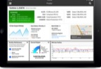

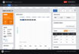
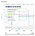
How equipment health analytics can enable fleet-wide operational optimization: Mining Trucks Example ...
Historical sensor data & maintenance data from Equipment and Operators, and the enviromental data
Failure mode-level, Component-level, Unit-level Failure Risk Models
Data-driven models estimate the failure risks
related to each failure mode, component-level, and unit-level, considering actual wear & tear
Fleet of
Mining Equipment
(instrumented)
Extracting features from
Sensor and Operation data (payload, fuel consumption, usage hours),
Maintenance text mining
used for inferring important failure events and component replacement/repair history.
Economically Optimal Condition-based & Predictive Maintenance
The failure indicator
is used for estimating RUL and recommending maintenance actions
Production and Maintenance optimized
Reduce the total downtime and maintenance cost over the fleet
Notes:
The Industrial Internet enables us to build new applications of asset maintenance and performance optimization by analyzing industrial big data from sensors and operators and other data related to operating conditions.
Here we build a economically optimized failure indicator of truck components such as engines, tyres and hydraulic systems.
Then, the failure indicator will be used for recommending maintenance actions.
Thus, it is important to relate the previous sensor events or historical runtimes, consumed fuels, carried payloads to the future failure events.

Slide 3
ABM Predix Apps Development
ABM Predix Apps
LAYER 4
ABM Apps for the client need & UX
ABM Toolkit for Predix Apps
Specialized functions for ABM data prep, ABM models
(e.g., failure risk indicators, survival analysis)
and model result representations
LAYER 3
DS Toolkit for Predix Apps
General functions for basic data prep, ML algorithms,
exploratory analysis, etc.
LAYER 2
Predix Platform
LAYER 1
Predix Analytics Development Platform

Slide 4
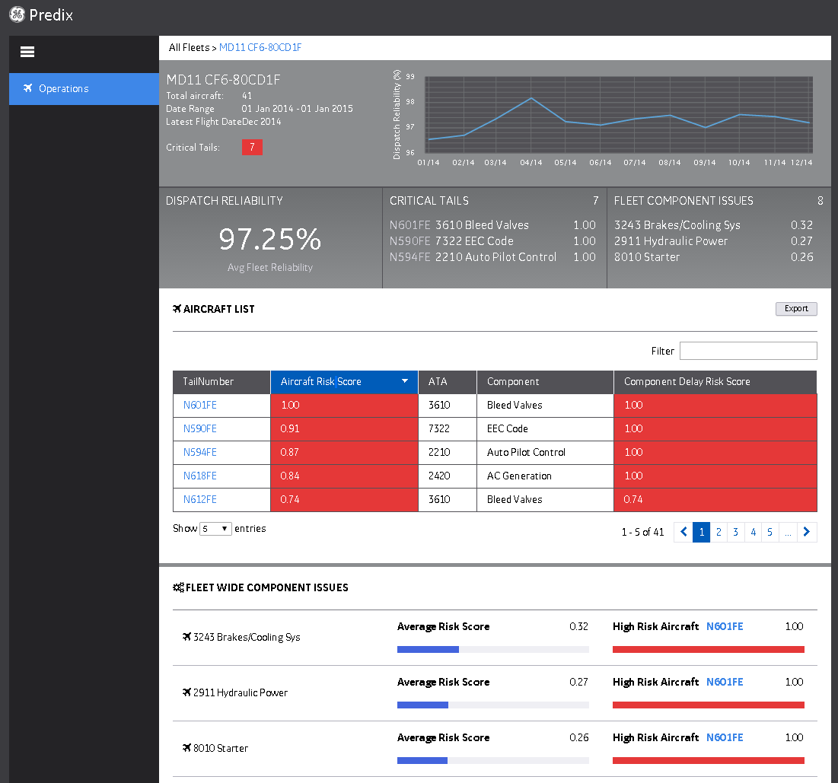
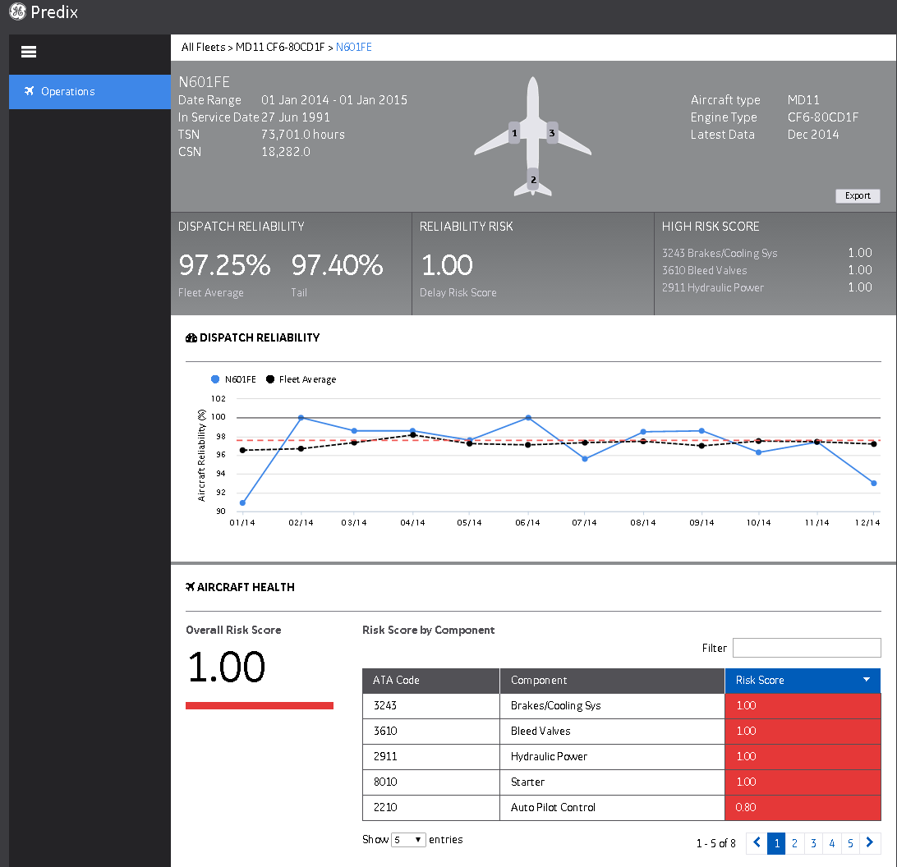
Fleet View
(Example) ABM Predix App for an Aviation Client
Tail Number View
Drill Down to Components Driving Tail Number Risk

Slide 5
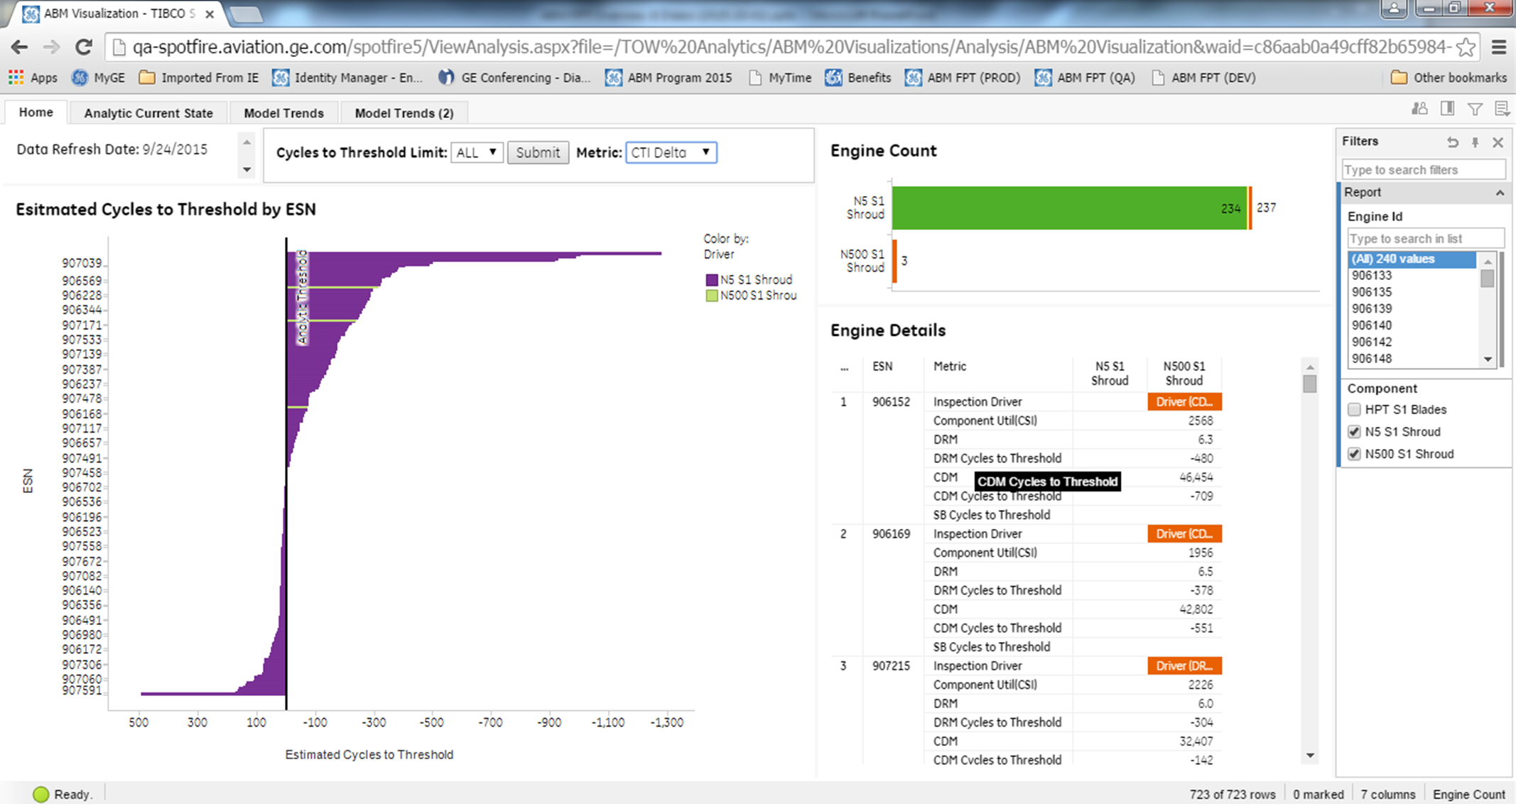
(Example) ABM Predix App for an Aviation Client
Rank order by largest change in cycles to threshold since last refresh date

Slide 6
Typical ABM data schema
Operation data
Unit Operation
unit id, timestamp (e.g., date), cycles, runtime, consumed power, cumulative cycles, cumulative runtime, ...
Component Operation
comp id, timestamp, on-time, ...
Sensor data
sensor id, unit id, comp id, timestamp, measurement type, measurement value, ...
Maintenance data
Unit Configuration
unit id, unit type, unit manufacture type, location, install id (repair count), install date, removal date, ...
Component Configuration (often needed to infer from Maintenance Report by text mining)
comp id, comp type, unit id, comp manufacture type, comp group type (parent comp type),
install id (repair count), install date, removal date, event on removal (failure type), ...
Maintenance Reports
report type, unit id, comp id, event, description, ...
Failure Modes (often needed to infer from Maintenance Report by text mining)
failure mode id, failure type description, comp type, unit type, failure group id (parent failure mode id)
Environmental data (weather, geographic, ... )
location, date, measurement type, measurement value, ...
Notes:
Operation data
Unit Operation
unit id, timestamp (e.g., date), cycles, runtime, consumed power, cumulative cycles, cumulative runtime, ...
Component Operation
comp id, timestamp, on-time, ...
Sensor data
- sensor id, unit id, comp id, timestamp, measurement type, measurement value, ...
Maintenance data
Unit Configuration
unit id, unit type, unit manufacture type, location, install id (repair count), install date, removal date, ...
Component Configuration (often needed to infer from Maintenance Report by text mining)
comp id, comp type, unit id, comp manufacture type, comp group type (parent comp type),
install id (repair count), install date, removal date, event on removal (failure type), ...
- Maintenance Reports
report type, unit id, comp id, event, description, ...
Failure Modes (often needed to infer from Maintenance Report by text mining)
failure mode id, failure type description, comp type, unit type, failure group id (parent failure mode id)
Environmental data (weather, geographic, ... )
location, date, measurement type, measurement value, ...

Slide 7
Functional Modules for ABM Predix Toolkit
Descriptive Analytics
Text Mining Toolkit for Component configuration inference and Failure Mode Analysis
Survival Analysis in Population
(All Sample Instances)-level
Data Prep, Feature Gen, Labeling for Time & Cycle-based
Modeling Tasks
Feature Selection
Hierarchical Failure Risk Models:
failure mode-level →
component-level → unit-level
Model Result Presentation
Maintenance Policy Optimization
Model Learning to Model Execution
Notes:
Descriptive Analytics
Text Mining Toolkit for Component configuration inference and Failure Mode Analysis
Data Preparation, Feature Generation and Labeling for Time & Cycle-based Modeling Tasks
Survival Analysis in Population (All Sample Instances)-level
Feature Selection
Hierarchical failure risk models (failure mode → component-level → unit-level)
Model Result Presentation
Maintenance Policy Optimization
Model Learning to Model Execution

Slide 8
Descriptive Analytics
Exploratory analysis toolkit (derived from DS toolkit)
Statistical plots, tables
– Fleet overview
Unit-level
Component-level
Failure mode-level
...

Slide 9
Anti-Ice Valve Removal Trends
(Example) Descriptive Analytics
Year of Removal
Month of Removal
Count
Count
Average Cycles at Removal
Cycles
CPN

Slide 10
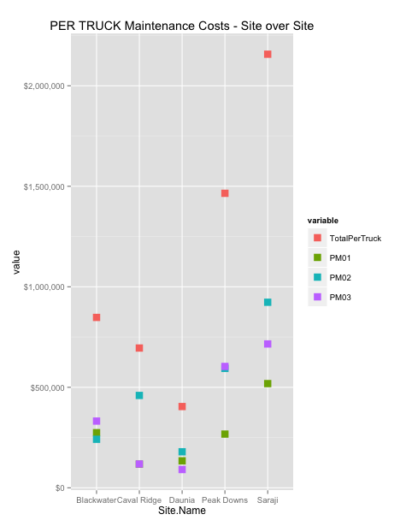
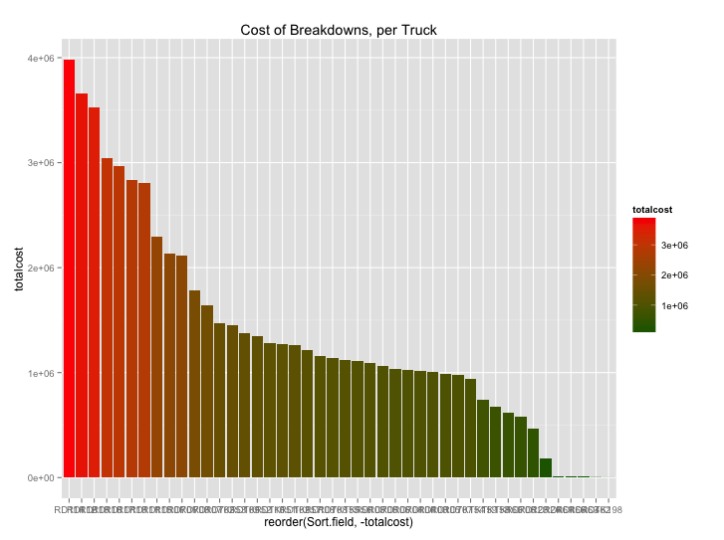
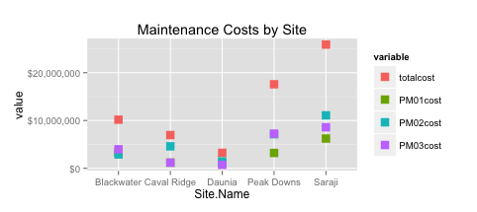
Data: We started by looking at Work Orders data …
(Example) Descriptive Analytics
Total Cost (repair) cost of breakdowns
Frequency of break-downs
Trucks, grouped by Mine Sites
Average Cost of Breakdowns
Truck by Truck comparisons
Site over Site Comparisons

Slide 11
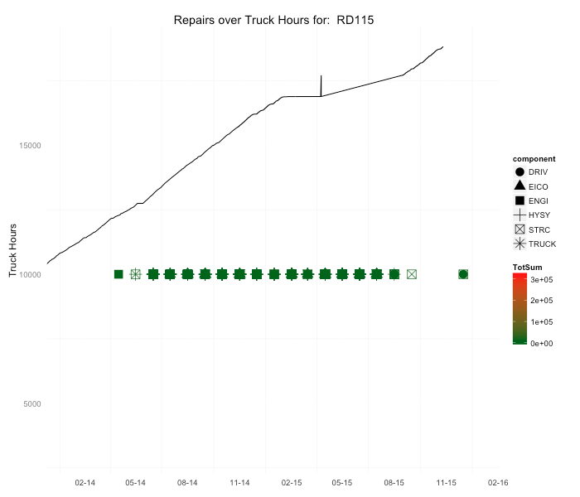
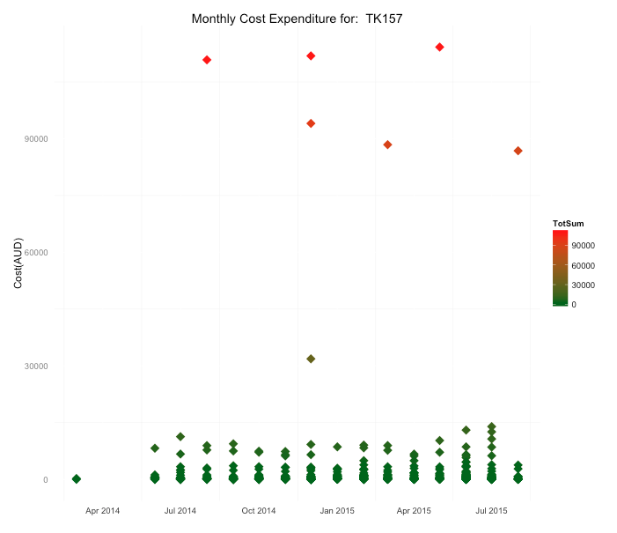
Work Orders data, plotted by Calendar Time
(Example) Descriptive Analytics
Calendar Time-based Exploration
Calendar Year
Monthly Expenditure by Truck
Lifetime analysis – Repair events across Engine Hours

Slide 12
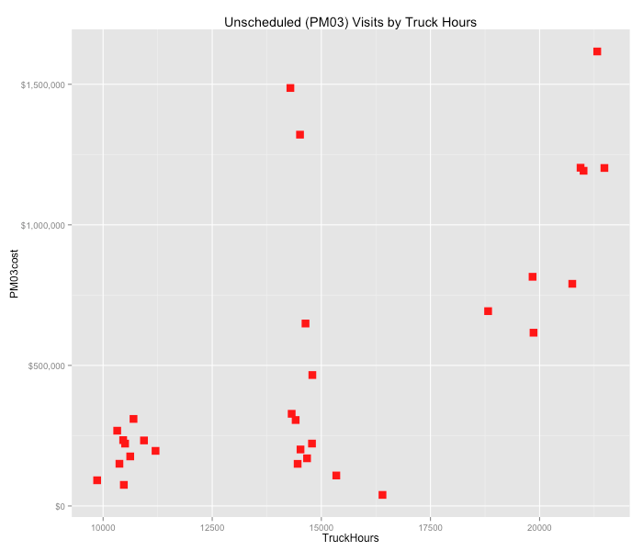
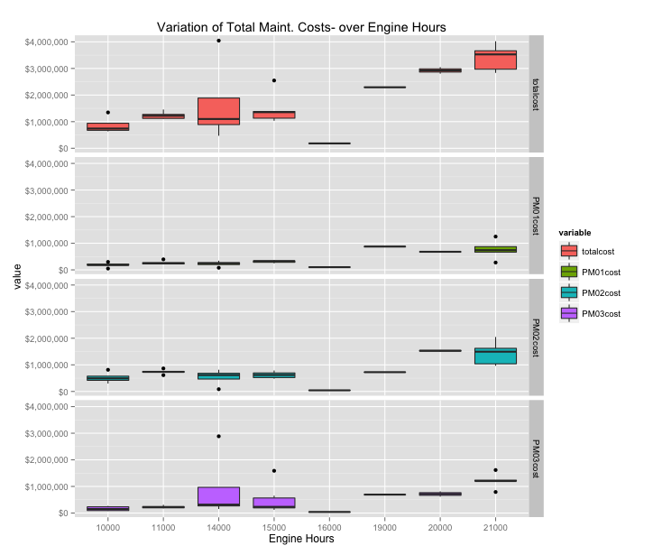
Maintenance Cost Variation over Truck Hours
(Example) Descriptive Analytics
Cost variability over Truck Hours
Each dot is one truck

Slide 13
Text Mining Toolkit Component configuration inference, Failure Mode Analysis
Component historical configuration inference (start date, end date, usages over cycles, event on removal) from text descriptions (work order texts, etc.)
Failure mode inference - Generating Forecasting Task Labels: Identifying the key events (failure modes) from text descriptions (work order texts, etc.)
Generating Forecasting Task Features: Identifying the key features from text descriptions (work order texts, etc.)
Association rule mining based on identified events and features
Industry-based word dictionary for text mining
Hierarchical Failure Definition/Description (e.g., Unit level > Component level > Subcomponent level > Upper-level Failure mode > Lower-level Failure mode > .. )

Slide 14
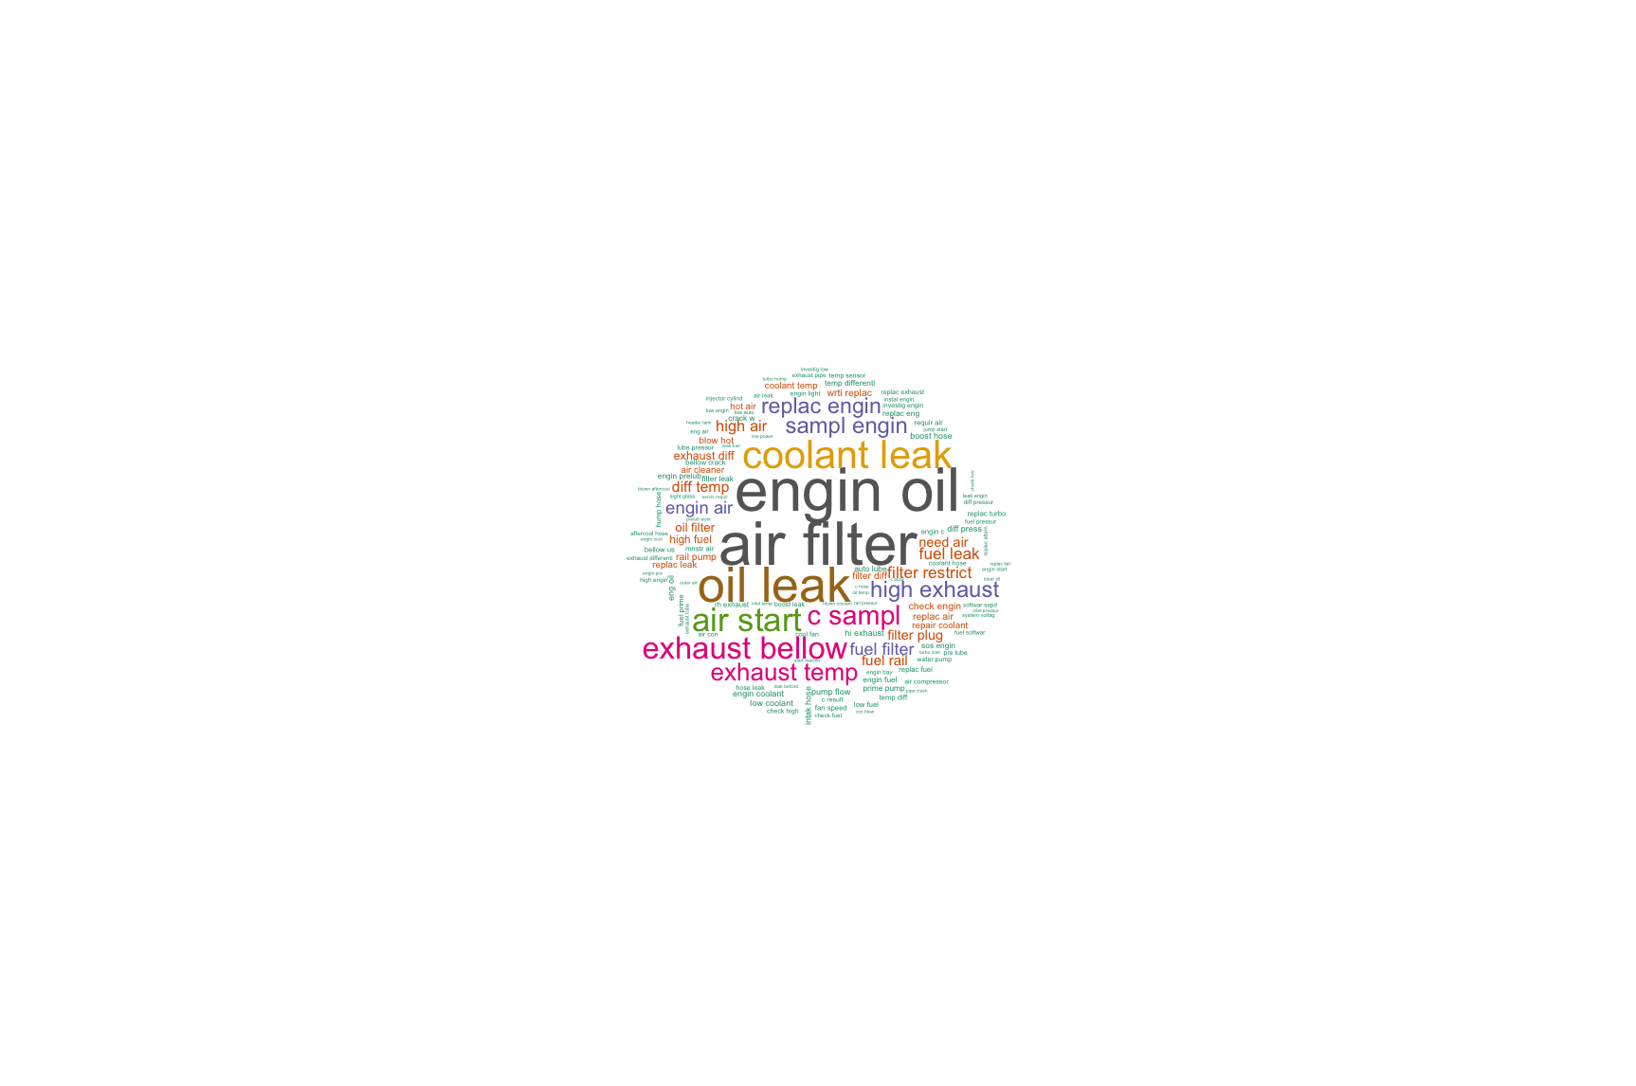
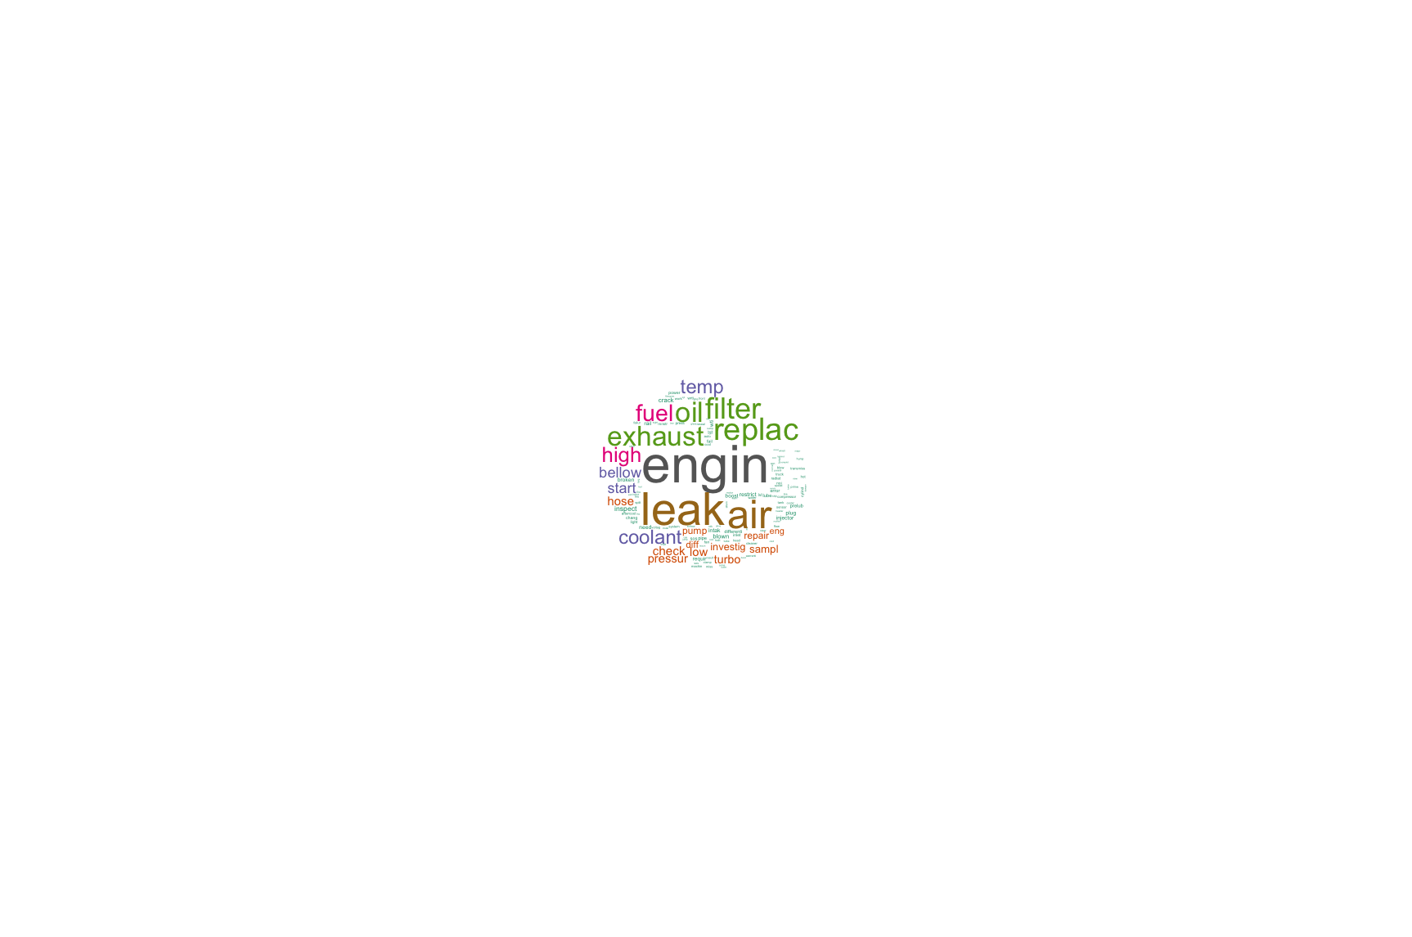
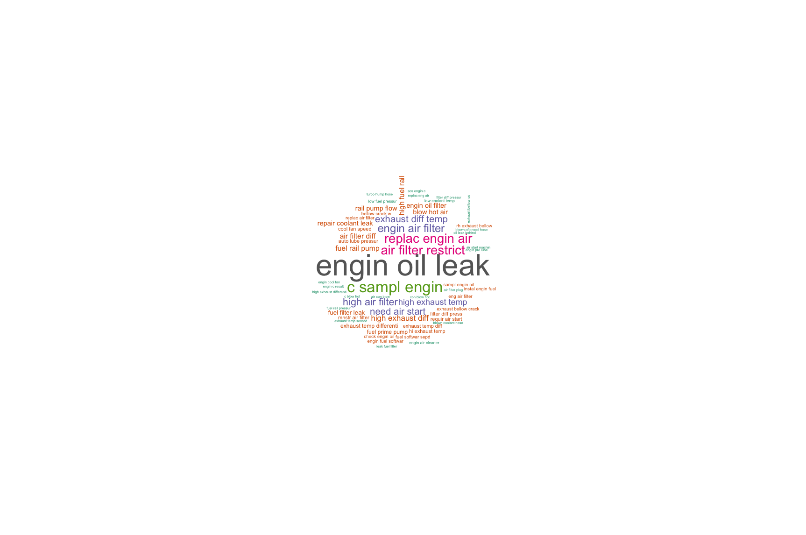
Identifying Failure Modes via Text Mining
(Example) Text Mining
Execution Methodology & Insights
Component (Functional Location) : Engine
764 records identified
Top 10 Frequent Failure Modes Identified:
Engine oil leak 2. Coolant leakage 3. Air filter 4. Filter plug 5. Sample engine 6. Fuel 7. Exhaust 8. Air start 9. Engine oil 10. Oil leakage
1 gram
2 gram
Feedback needed from BMA: Need domain knowledge to combine pairs of Component-level failure modes identified via Text Mining
3 gram
BMA 797F Truck Optimization FTO
Privileged and Confidential

Slide 15
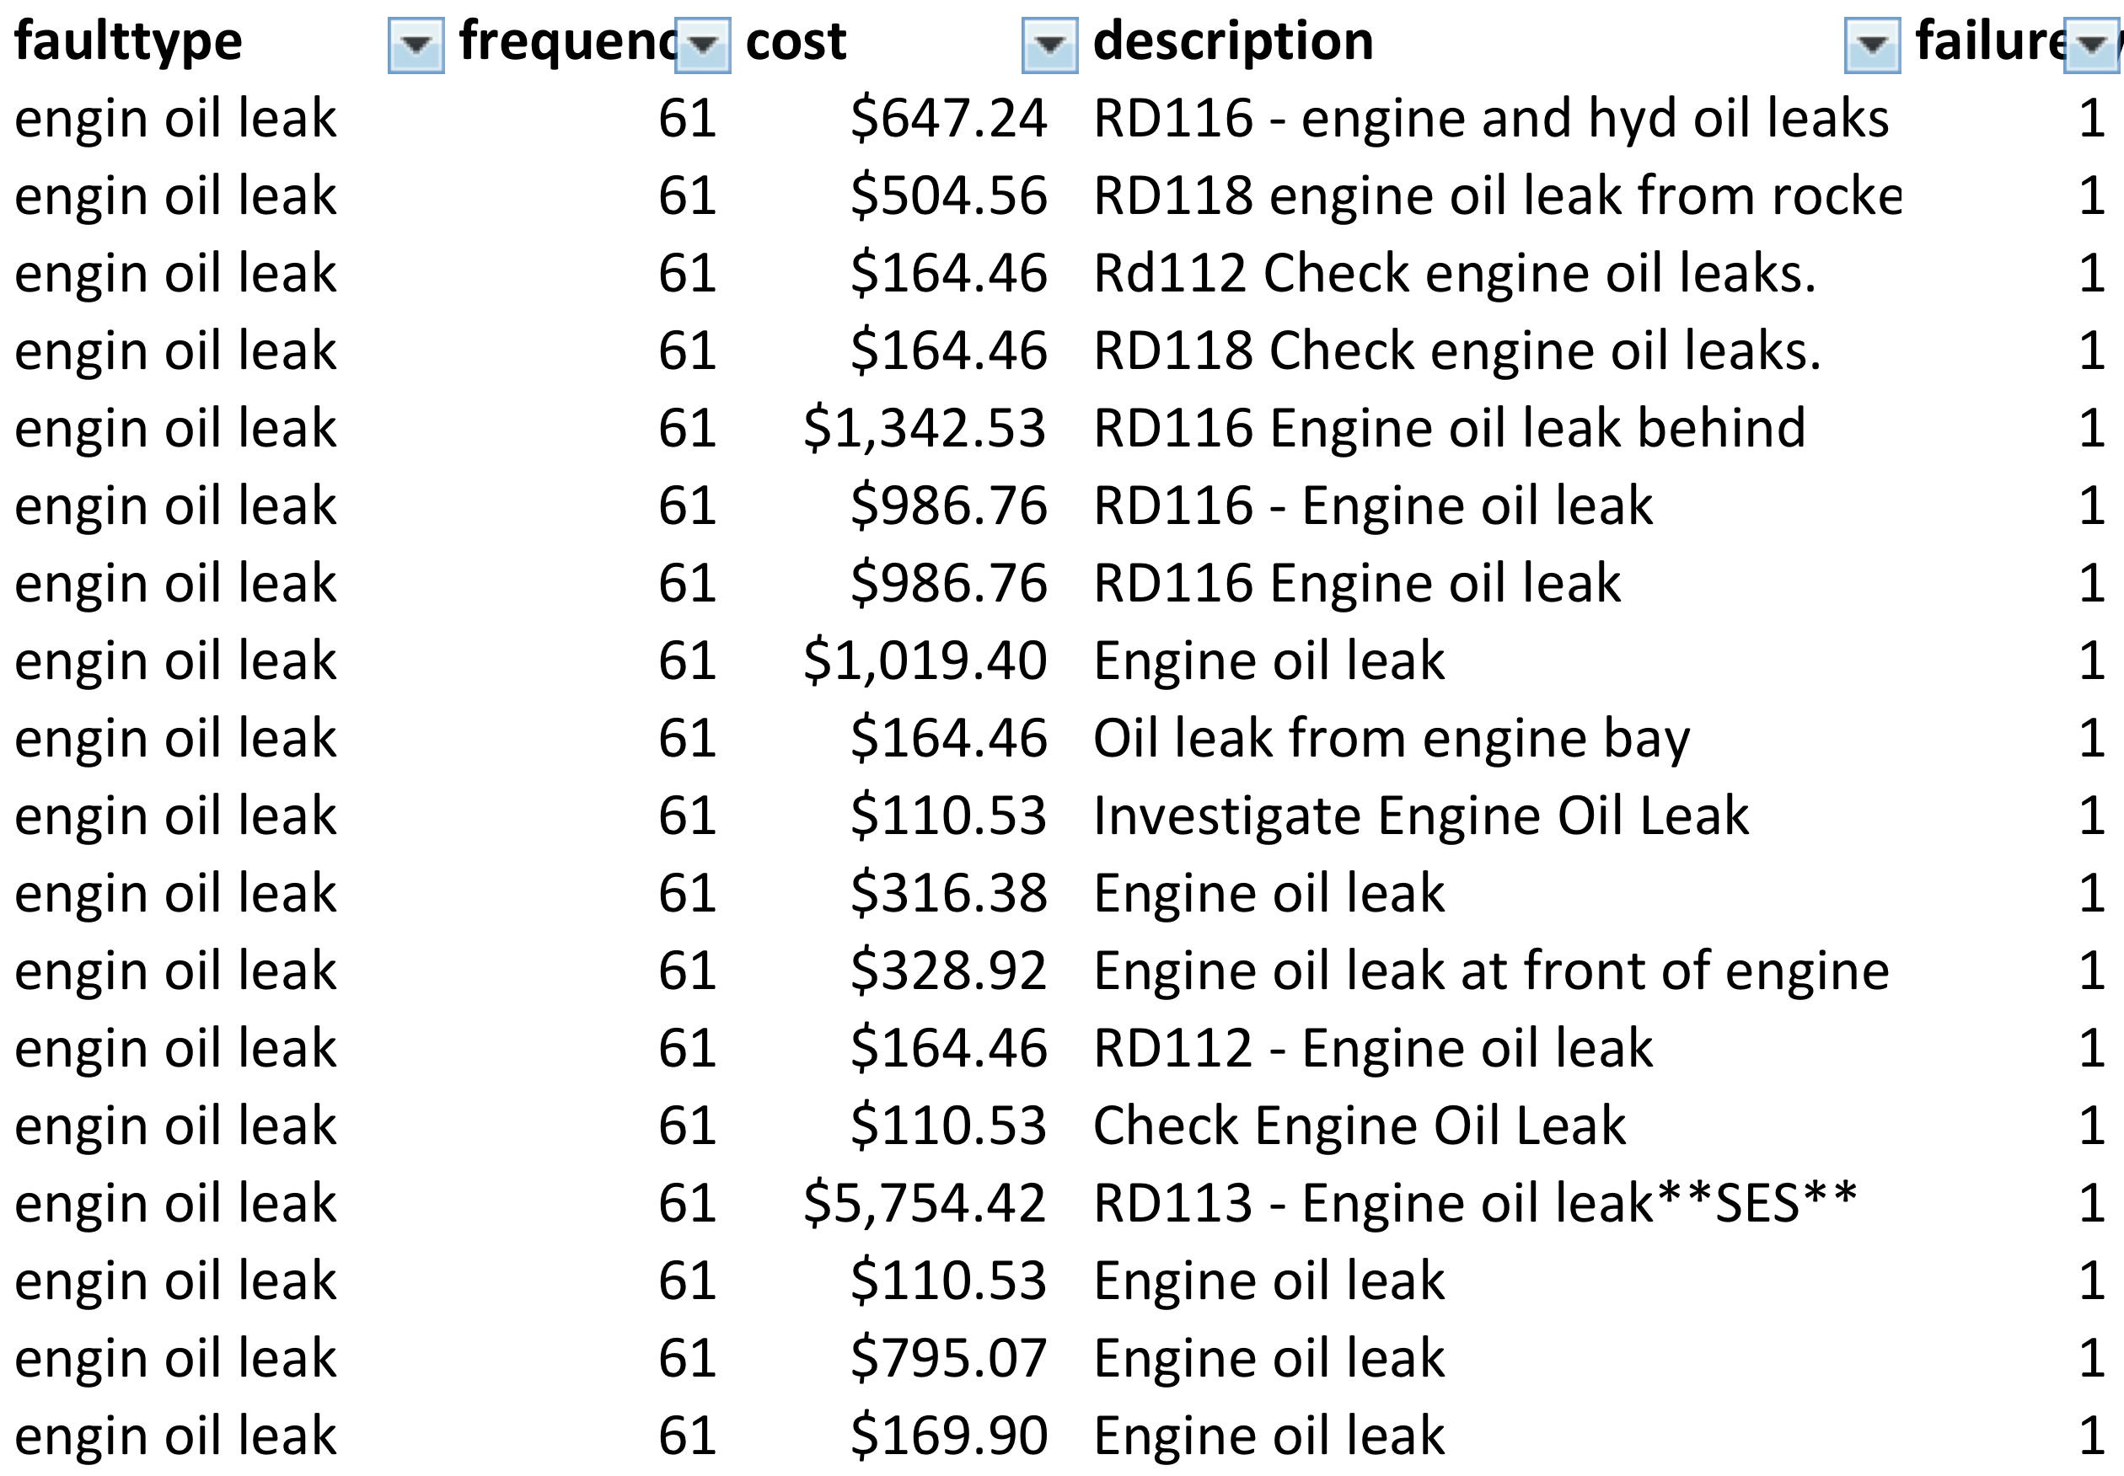
Subcomponents Failure Identification
(Example) Text Mining
Execution Methodology & Insights
Component (Functional Location) : Engine
764 records identified as major failure
Major Failure Modes:
1. Engine oil leak 2. Coolant leakage
3. Air filter 4. Filter plug 5. Sample engine
6. Fuel 7. Exhaust 8. Air start 9. Engine oil
10. Oil leakage
3 gram
2 gram
BMA 797F Truck Optimization FTO
Privileged and Confidential
1 gram

Slide 16
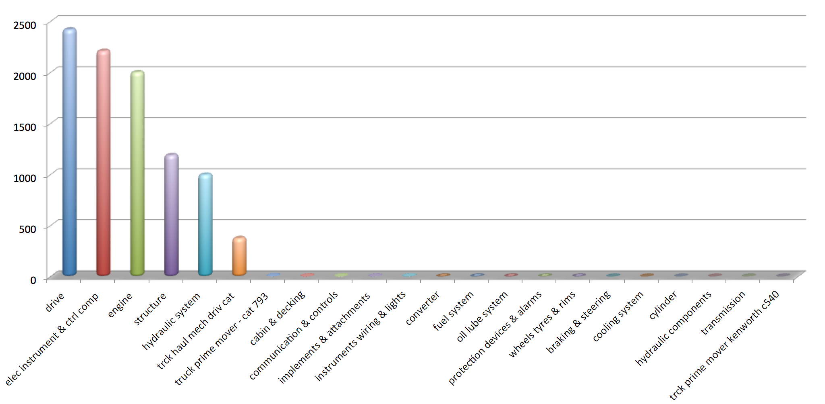
Frequency of Failures (Based on Work Order)
(Example) Text Mining
Execution Methodology & Insights
Top 6 components:
Drive
Electric Instrument & Control Components
Engine
Structure
Hydraulic System
Truck Haul Mechanical Drive Cat
Number of Failures
BMA 797F Truck Optimization FTO
Privileged and Confidential

Slide 17
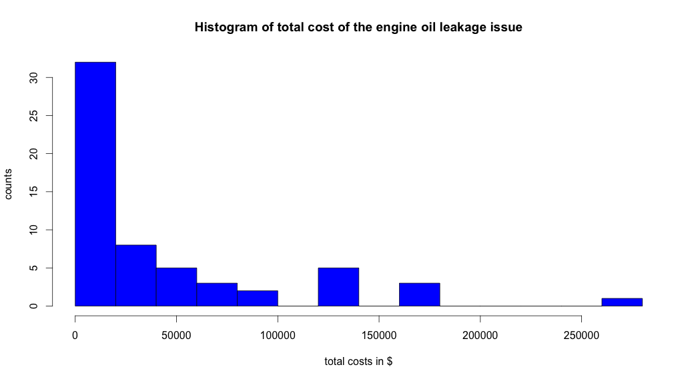
ENGINE: Avg. Cost of Identified Failure Modes
(Example) Text Mining
Execution Methodology & Insights
Failure Modes of the Functional Location: Engine
Average Cost
Engine Oil Leak: Cost Histogram .
Total cost =
repair cost + downtime cost
downtime cost rate
$150/hour
Engine oil leakage is selected.
Frequency
Total Cost Incurred (AUD)
BMA 797F Truck Optimization FTO
Privileged and Confidential

Slide 18
Survival Analysis in Population (All Sample Instances)-level
Survival analysis
Nonparametric KM
Parametric models (Weibull, Reyleigh, etc.)
Traditional measure estimation
Mean Time Between Failures (MTBF) for each failure mode
Optimal scheduled maintenance time based on time-based failure distribution (inferred from survival analysis)
Risk Frontiers Representation

Slide 19
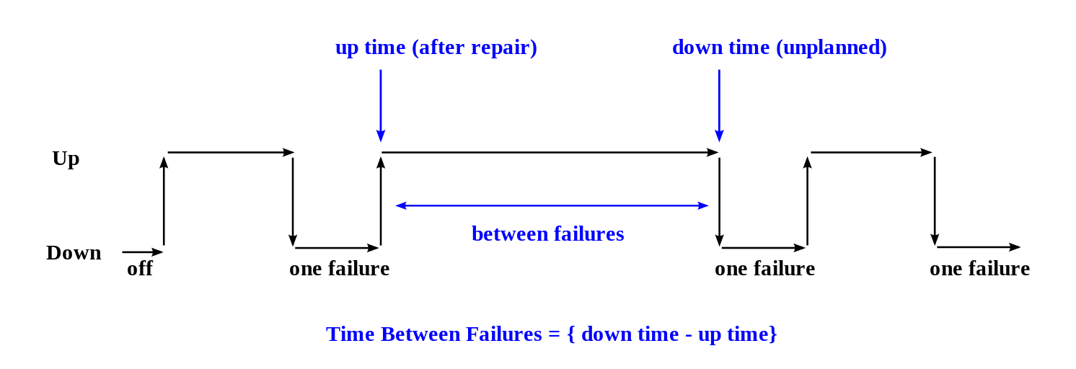
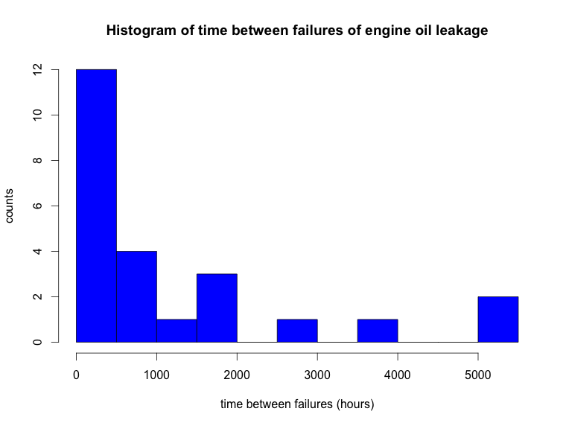
Engine Oil Leakage Issue: Time between Failures
(Example) Survival Analysis
Mean Time between Failures(MTBF) : 1223.738 Engine Hours
BMA 797F Truck Optimization FTO
Privileged and Confidential

Slide 20
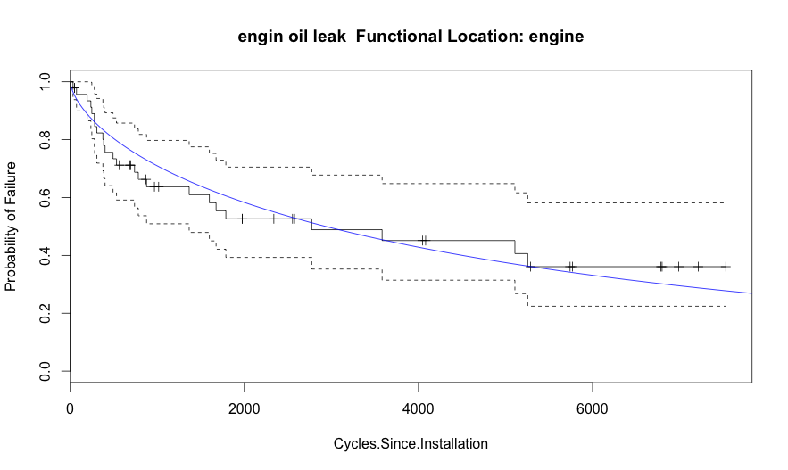
Survival Function Estimation
(Example) Survival Analysis
Engine Oil Leakage Issue
Survival probability
Time (Engine Hours)
Survival probability drops quickly before 1000 hours. This indicates that there could be another failure mode causing this early failures
BMA 797F Truck Optimization FTO
Privileged and Confidential

Slide 21
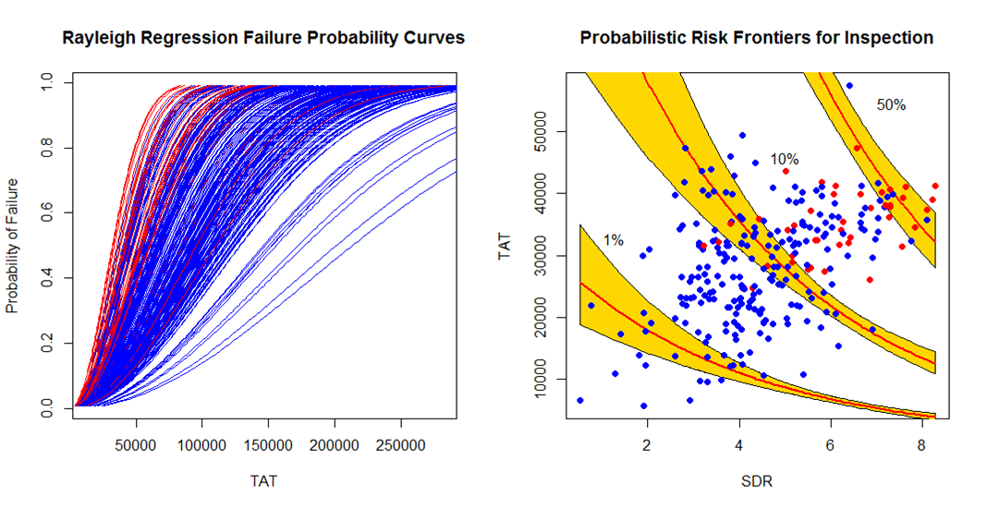
(Example) Survival Analysis
Probabilistic Risk Based Inspection Rayleigh Regression
Hazard(TAT, SDR) = RayleighHazard(TAT) * exp[beta * SDR], fitted using the last sample values only
Inspect More
Min Probability of N500 Hole
Inspect Less
Prioritize Inspections and Inspection Frequency based on Risk Frontiers

Slide 22
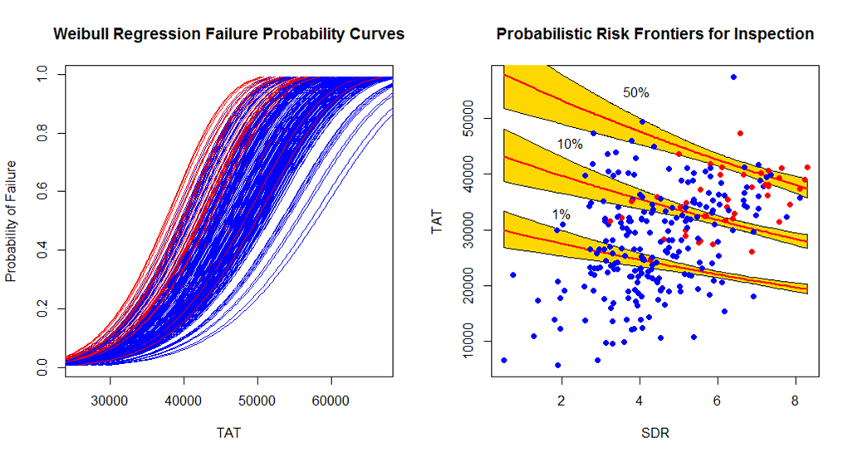
(Example) Survival Analysis
Probabilistic Risk Based Inspection Weibull Regression
Hazard(TAT, SDR) = WeibullHazard(TAT) * exp[beta * SDR], fitted using the last sample values only
Prioritize Inspections and Inspection Frequency based on Risk Frontiers
Notes:
S(t) = exp{−(λt)^p}, and the hazard is
λ(t) = p (λ^p) (t ^(p−1)).

Slide 23
Data Preparation, Feature Generation and Labeling for Time & Cycle-based Modeling Tasks
Functions for transforming irregularly-sampled data to regularly-sampled data
e.g., transform irregular alert events to cumulated number of alerts over days
e.g., transform the daily sample data with missing dates to regularly-sampled data filled-in for missing dates
e.g., transform it to rolling-window based mean/median/sum/count data and cumulative mean/median/sum/count data (e.g., cumulative since the component installation, cumulative since the unit installation) for Component-level/Unit-level analysis
Functions for different kinds of labeling assignment (healthy vs. failure) of classification tasks
Function to easily add new time/cycle-based features (derived features, rule-based features, physics model-driven features, etc.)
Advanced signal processing functions for enhancing the interested signatures (wavelets, empirical mode decomposition, ...)
Feature-engineering or Dimensionality-reduction methods such as kernel PCA, manifold learning, and autoencoder network in deep learning.

Slide 24
(example) classification setup
(Example) Data & Label Prep
First, we generate time-based sample points (e.g., one sample per day (or per cycle) from healthy and failure components. Each sample point has features calculated over the last N-days (N-cycles) time window or cumulated window.
Second, we label as “Unhealthy class” only the sample points within a pre-specified time window (a model parameter) ahead of the failure time of each failure component. Other remaining sample points are labeled “Healthy class”. This assumes that the failure component was in unhealthy state with this specified time window.
Time Window – a given modeling parameter for classification label
Unhealthy
Healthy
Component Install
Failure

Slide 25
Feature Selection
RandomForest/GBM Importance Ranking,
Feature Sensitivity Analysis (e.g., how does 10% increase/decrease of the mean value of a selected feature change the ranking?)
Marginal effect plot (plotting the marginal effect of a selected feature by integrating out the other features), e.g., partialPlot in R randomforest
Univariate CoxPH based feature importance
Feature Distribution (healthy vs. failure samples) based feature importance, Mean-value Separation (p-value, AUC)
Easy plots to check the feature value changing over time or cycles
Regularization-based feature selection
Integrated with Correlation-based feature clustering to remove redundant feature selection

Slide 26
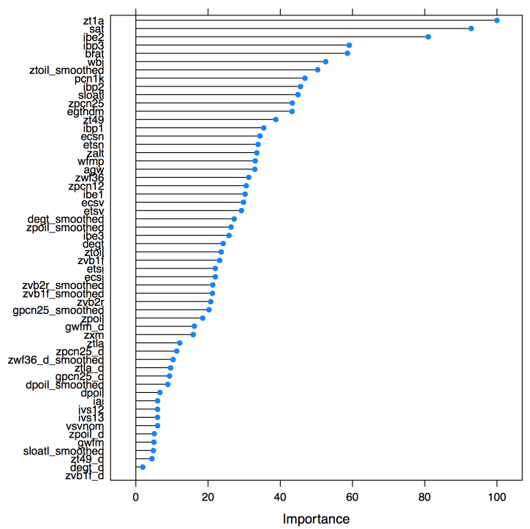
(Example) Feature Selection
Failure (removed) components vs. Working components
Binary classification setup: for each unit, assign “unhealthy” label to all sample points within given #cycles before actual removal. Note that this #cycles is one modeling parameter.
Univariate filter approach:
For each feature in Snapshot/CEOD,
measure the feature’s discriminability of two classes
(healthy, unhealthy), e.g., p-value, AUC,
Univariate CoxPH coefficient significance test
Classification/Boosting approach
Identify & rank relevant features that are critical
in classification, e.g., Random Forest
unhealthy
healthy
Install
Removal

Slide 27
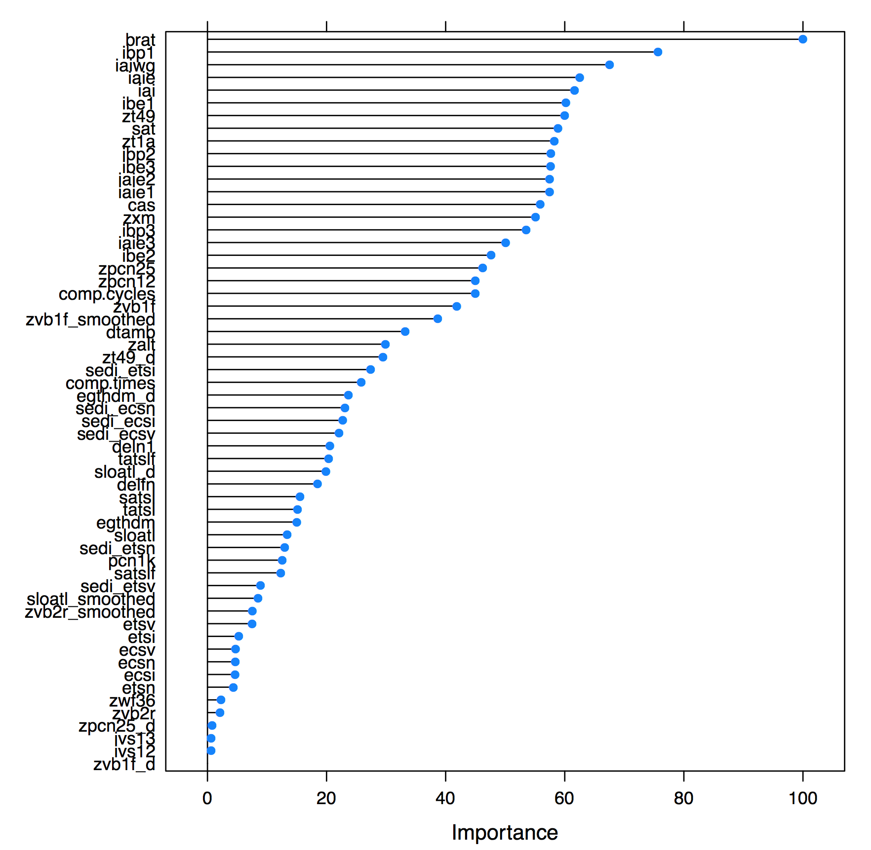
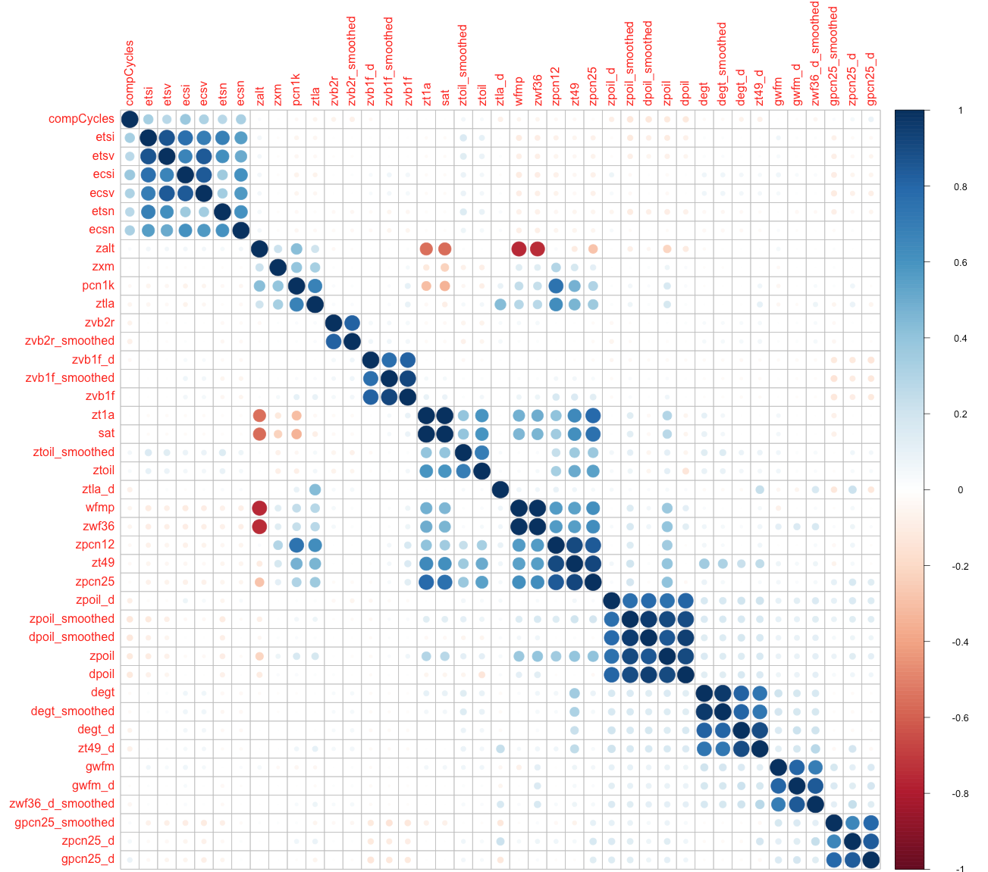
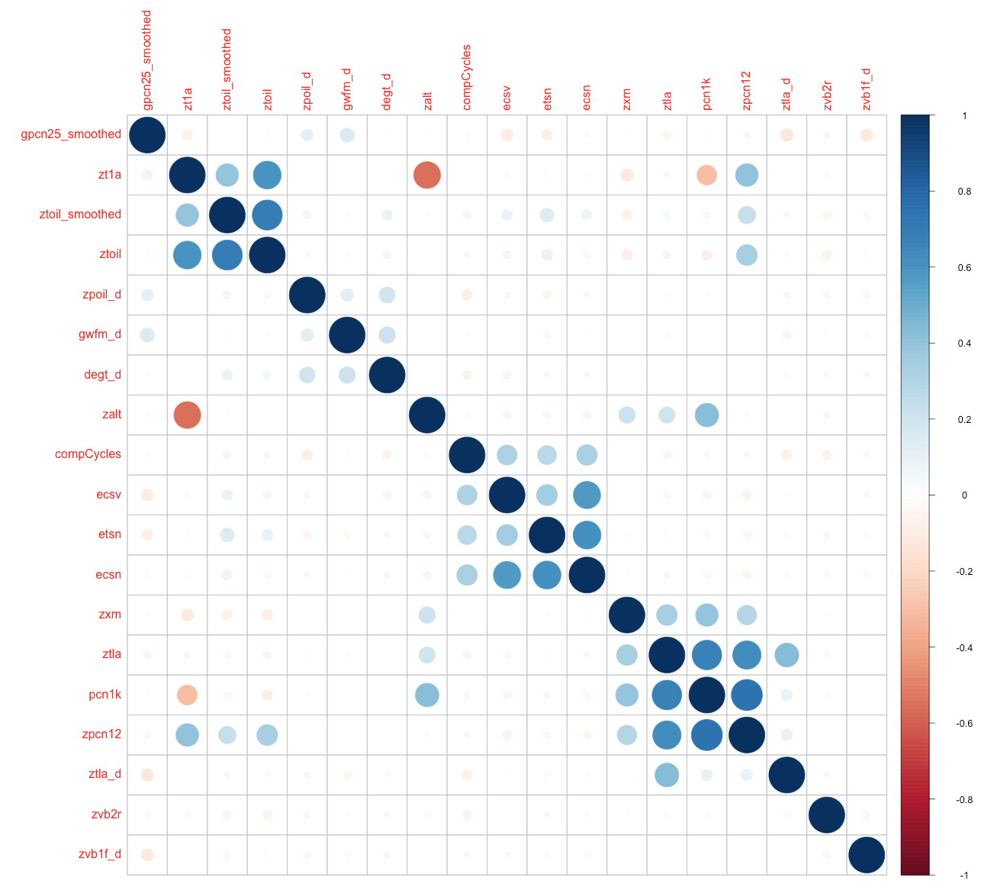
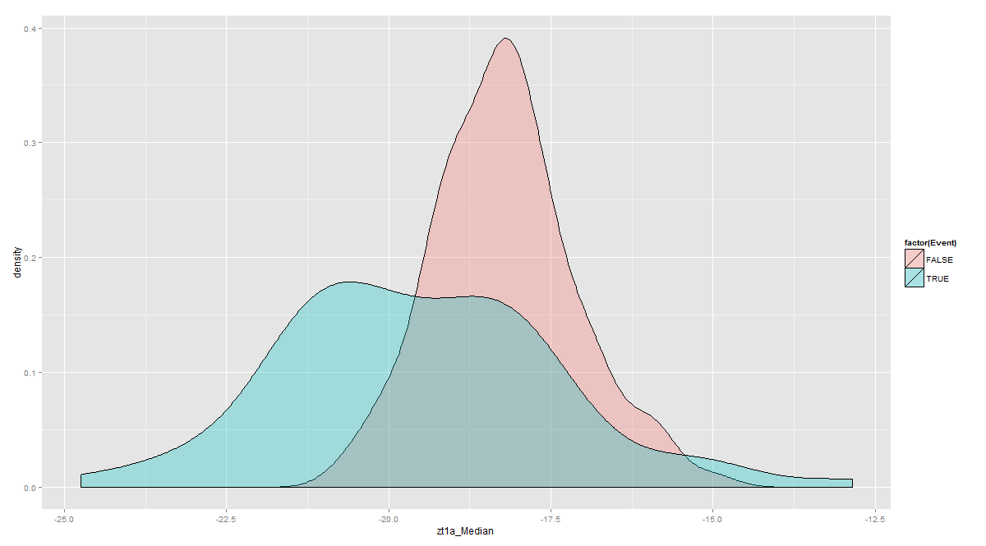
(example) Feature Selection Flowchart
(Example) Feature Selection
Field Experts
Knowledge
Random Boost
Importance Ranking
Remove
Low quality
Features
Correlation
Analysis
Selected
Feature
Features
Univariate
filter approach
(Mean separation,
CoxPH)

Slide 28
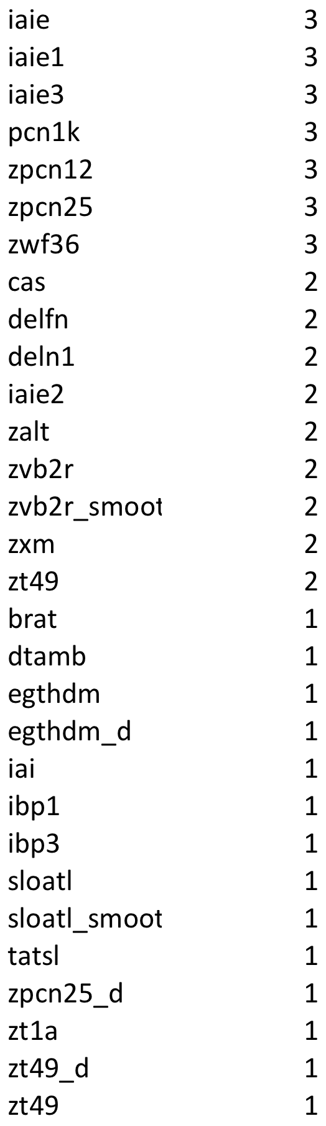
(Example) Feature Selection
Combined
Results with
Redundant Removed
Mean
Separation
Random
Forest
Univariate
CoxPH
Combined
Results (voting)
cas
pcn1k
defn
deln1
zxm
zpcn12
zpcn25
Iaie
Iaie2
Zt49
zvb2r_smoothed
zvb2r
iaie3
zwf36
ibp3
zalt
iaie1
pcn1k
cas
zpcn12
zxm
Iaie
iaie3
dtamb
iai
tatsl
iaie1
brat
zwf36
ibp1
zt1a
zpcn25
iaie
comp.cycles
iaie2
zvb2r_smoothed
iaie1
iaie3
zt49_d
zvb2r
zwf36
egthdm
sloatl
zt49
zalt
zpcn25
zpcn12
sloatl_smoothed
deln1
pcn1k
delfn
zpcn25_d
egthdm_d
iaie
pcn1k
zpcn12
zwf36
cas
zalt
zvb2r
zvb2r_smoothed
iai
ibp3
sloatl_smoothed
zpcn25_d
zt1a
zt49_d
Redundancy
Removal
+
+
=

Slide 29
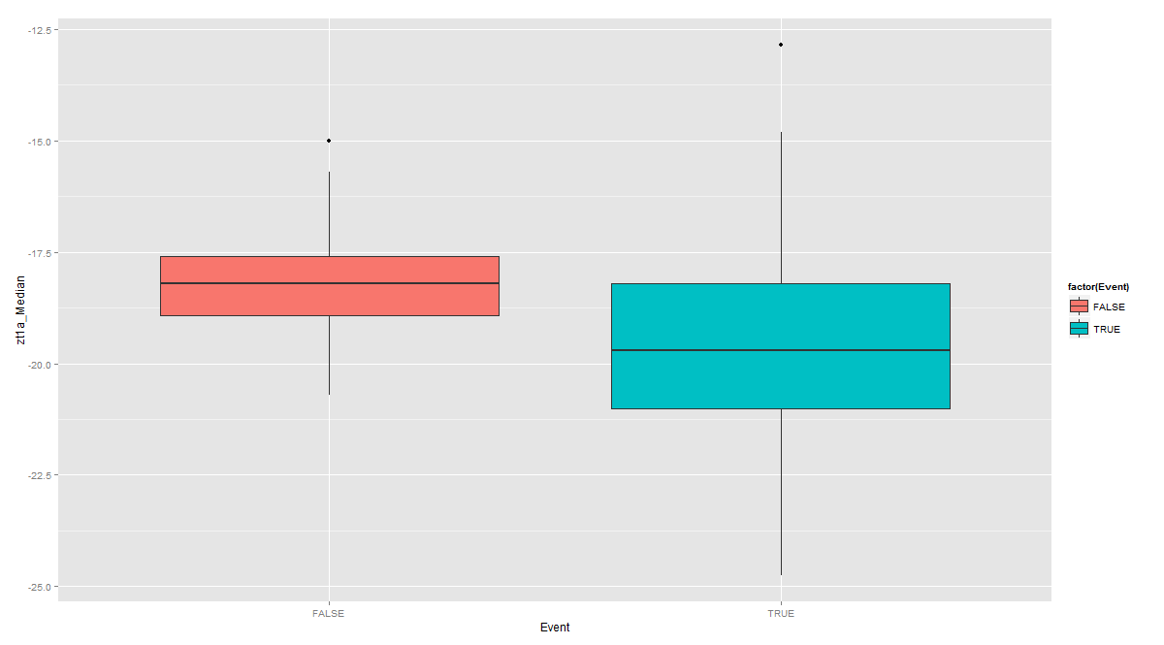
(Example) Feature Selection
CRUISE Features | p-value | imp.factor
zt1a_Median | 2.33E-06 | 20625
zt1a_75th_perc | 3.84E-06 | 12312
sat_Median | 5.74E-06 | 8162
zt1a_25th_perc | 1.17E-05 | 4037
zt1a_Mean | 1.18E-05 | 3916
sat_75th_perc | 1.24E-05 | 3711
zxm_Median | 2.03E-05 | 2184
etsn_25th_perc | 3.59E-05 | 1240
etsi_25th_perc | 4.95E-05 | 894
zxm_Mean | 5.66E-05 | 778
TAKEOFF Features | p-value | imp.factor
dtamb_75th_perc | 1.91E-03 | 1345
satslf_75th_perc | 1.12E-03 | 1345
satsl_75th_perc | 5.41E-04 | 1345
tatslf_75th_perc | 3.86E-04 | 1136
tatsl_75th_perc | 5.09E-05 | 1136
zalt_75th_perc | 3.47E-05 | 838
sat_75th_perc | 3.47E-05 | 92
zt1a_75th_perc | 2.96E-05 | 63
etsi_25th_perc | 2.96E-05 | 38
etsn_25th_perc | 2.96E-05 | 21
Ranked Cruise and Takeoff Features
Top ranked features include ambient conditions and time/cycles
Cruise ZT1A – Median Total Inlet Temperature
2.5°C
2.5°C
Removals
Healthy
Healthy
Removals
Healthy
Removals
Notes:
Failure Probability/Hazard for each cycle is modeled by Classification/CoxPH

Slide 30
Hierarchical Failure Risk Models failure mode-level → component-level → unit-level
CoxPH models
time-dependent model over time-based sample points with selected features as time-varying covariates
time-independent model over components (end points) with selected features as time-fixed covariates
Classification models
Classification task (e.g., RandomForest, Logistic, SVM, GBM) over time-based sample points for healthy vs. unhealthy components
Classification task (e.g., RandomForest, Logistic, SVM, GBM) over end points for healthy vs. unhealthy components
Classification task with Reduced number of top N ranked features
CoxPH models using the the failure probability from Classification task as a covariate
Building the individualized failure indicator for each component using the failure risk from CoxPH models
Handling Imbalanced labeled data (SMOTE)
Cross-Validations using K-fold setup or Leave-one-component-out setup for any models
Automatic framework to find the best failure indicator model among all candidate models in terms of a testing criterion
Risk score with error band (95% confidence)
Hierarchical models
Component failure risk model on each failure mode → Component-level aggregator combining multiple failure modes
→ Unit-level aggregator combining component failure risk models

Slide 31
Component-level failure risk model (on a failure mode)
Failure risk model
1. Cox PH model with time-dependent covariates
Instant Hazard
A covariate with more frequent failures
will have larger estimated beta
where x₁(t), x₂(t) are time-dependent covariates
Cumulative Hazard H(t) = Σ_{t} h(t)
Cumulative Failure Probability P(t) = 1 – exp (-H(t) )
2. Classification model
(e.g.) logistic model
Classification
Failure probability at t
Cumulative Hazard H(t) = Σ_{t} h(t)
Cumulative Failure Probability P(t) = 1 – exp (-H(t) )

Slide 32
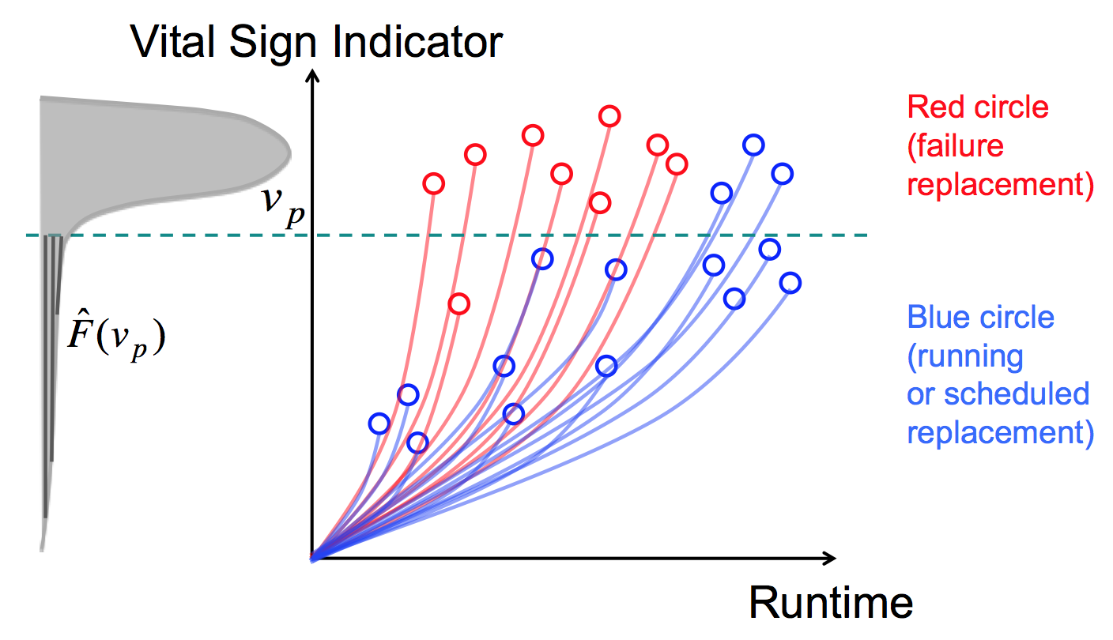
Building Hierarchical Failure Risk Models
Failure risk model
A failure risk model is built on each failure mode. This failure mode-level risk model assesses the failure risk with which a component has failure of the mode in component hours since the latest failure
Component-level failure risk model can be built combining the failure mode-level risk models in a component type (functional location)
Unit-level failure risk model can be built combining component-level failure risk models.
Failure Indicator
Component Hours
since the latest failure
Failure indicator values tend to rapidly increase near the actual failure
A threshold-based replacement policy can be designed based on this failure indicator
BMA 797F Truck Optimization FTO
Privileged and Confidential

Slide 33
Individualized Failure Indicator
Failure risk model
Individualized Failure Indicator
= Cumulative Failure Probability over component cycles (or component usage time) individualized for each component considering its real usage conditions
e.g., severe usages or harsh conditions may increase the likelihood of failure
Ideal failure indicator values should tend to rapidly increase near the actual failure
A threshold-based replacement policy can be designed based on this failure indicator
Failure Indicator
Component
Cycles
Notes:
Failure Probability/Hazard for each cycle is modeled by Classification/CoxPH

Slide 34
Failure risk model
Classification + Time-dependent CoxPH
A data-driven ML function model for the failure risk indicator is to combine a failure classification task with the time-dependent CoxPH model.
First, we generate time-based sample points (e.g., one sample per day (or per cycle) from healthy and failure components. Each sample point has features calculated over the last N-days (N-cycles) time window.
Second, we label as “Unhealthy class” only the sample points within a pre-specified time window (a model parameter) ahead of the failure time of each failure component. Other remaining sample points are labeled “Healthy class”. This assumes that the failure component was in unhealthy state with this specified time window.
Time Window – Variable Parameter for classification label
Unhealthy
Healthy
Component Install
Failure

Slide 35
Failure risk model
Third, we perform a classification task to classify healthy samples vs. unhealthy samples. This classification task also estimates the instant failure probability of each sample point.
Fourth, we use the instant failure probability estimate as one covariate in the time-dependent CoxPH model. Using the instant hazards over time from the time-dependent CoxPH model, we obtain a cumulative failure probability for an individual component over time and use it as our failure risk indicator.
Note that the failure risk indicator based on a cumulative failure probability is monotonically increasing over time and enables us to make a threshold-based maintenance policy in terms of the failure risk indicator.

Slide 36
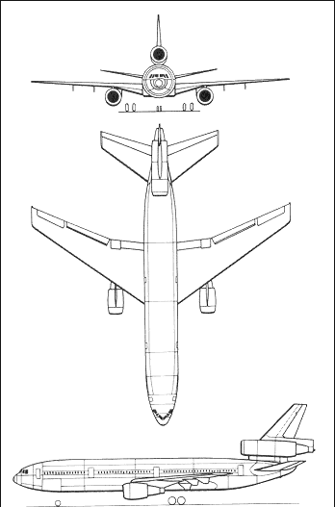
Analytic Output - Probability of Delay or Cancellation By Tail
Failure risk model
Tail Number P(failure) = Aggregated Component P(failure)
Starter Air Valve
Multiple Models to Aggregate Risk:
P_{tail} (t) = max { P_{j} (t) }
P_{tail} (t) = 1 - (1 - P₁ (t)) (1 - P₂ (t)) ... (1 - P_{J} (t))
P_{tail} (t) =
Thrust Reverser
Brakes
AC Generation
Bleed Valves
Method is Scalable to as many component models required to achieve desired fidelity and business outcome.
Etc …

Slide 37
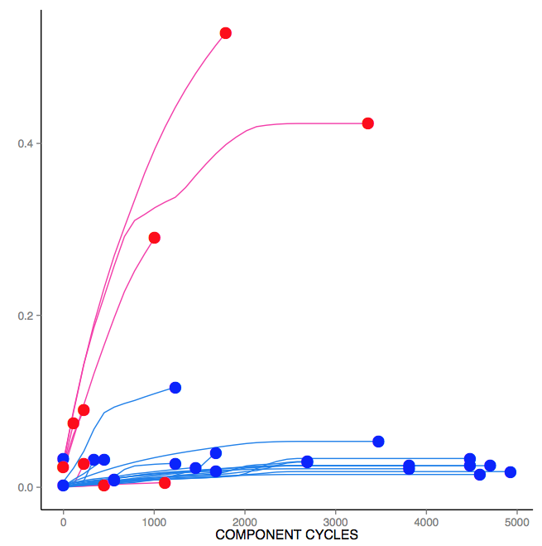
Individualized Failure Indicator for Engine Oil Leakage Failure Mode
(Example) Failure risk model
Generate Individualized Failure risk curves, for each engine.
An optimal threshold to schedule inspections could be calculated.
Individualized Failure Indicator
= Cumulative Failure Risk Score
over engine hours for each
component
A threshold-based inspection policy can be designed based on this failure indicator
Individualized cumulative failure risks score for a given component are calculated for each one, based on its VIMS characteristics
Individualized Failure Indicator
Each line represents one engine
Red represents engine where engine oil leakage failure occurred
Blue represents engines without engine oil leakage failure
Inspection action threshold
Engine Hours
Note: The scheduled inspection varies from engine to engine (different # of cycles)

Slide 38
Model Result Presentation
ROC plot, AUC calculations
Risk score vs. Component (or Unit) Index plot
Component Failure Risks for Each Unit

Slide 39
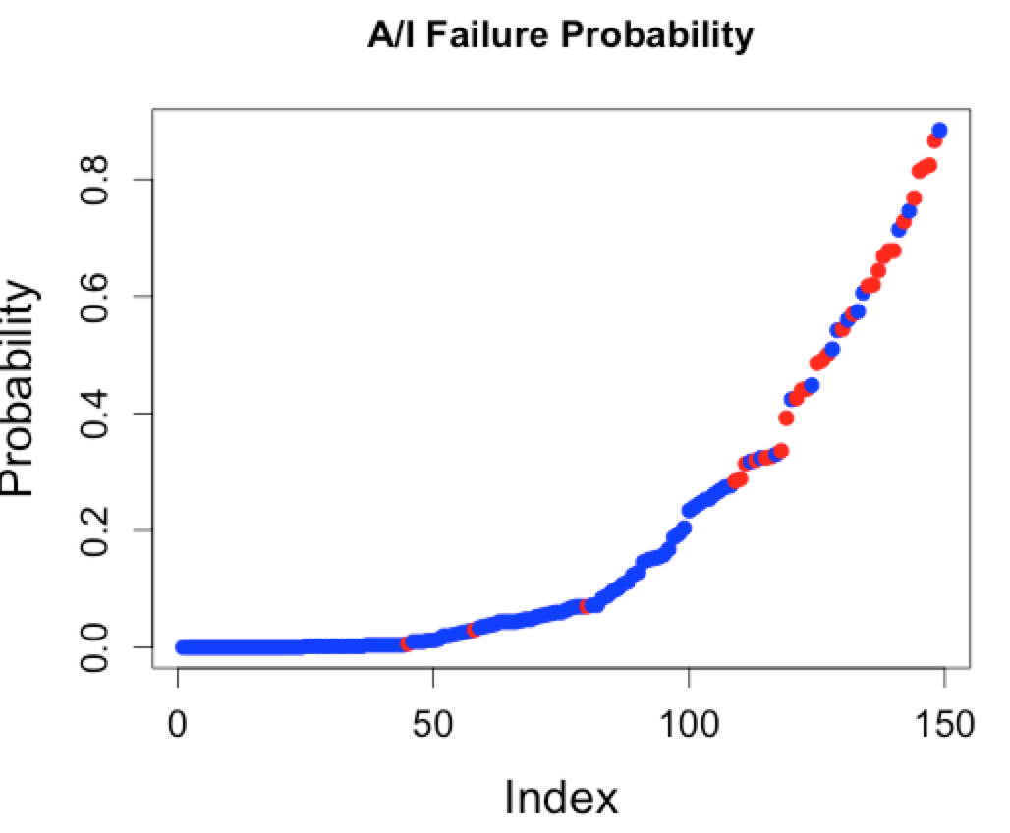
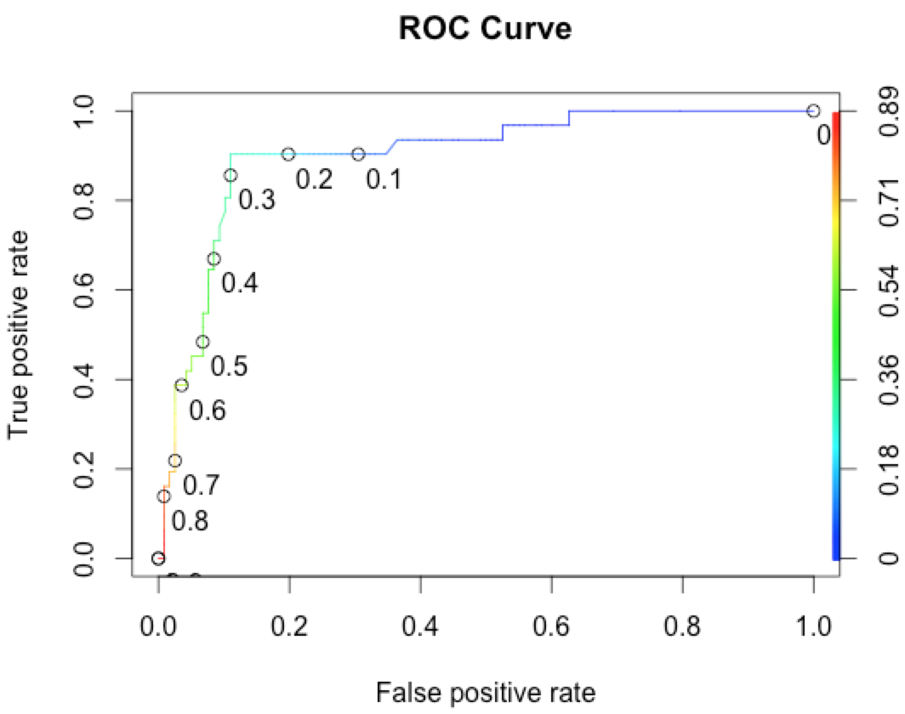
Classification Results with CEOD Features and Non-Overhaul, Non-Repair population removed, and short cycles population included.
(Example) Model Result Presentation
Component-wise binary classification
# Removed components = 31
# Healthy components = 118
Random Forest
Mean values used for selected features
leave-one-out cross-validation
Features:
duty_cycle, gross_weight_lbs_0_mean, to_iaie,
to_delfn, to_zxm, to_zvb1f_smoothed
Accuracy = 0.89
HitRate = 0.90
FalseAlarmRate = 0.11
A/I Valve Removals
Detection Threshold
 | Pr = No (Healthy) | Pr = Yes (Removed)
Healthy | 105 | 13
Removed | 3 | 28
ROC curve

Slide 40
Model Output Tail Risk Score = Aggregated Component Risks
(Example) Model Result Presentation
Total Tail Risk
Individual Component Risks
 | Predicted Risk Score
 | ATA CODE | 8010 | 7322 | 3610 | 2911 | 2420 | 3243 | 2210 | 7830
Tail | Tail Total Risk | Starter | EEC Code | Bleed Valves | Hydraulic Power | AC Generation | Brakes/Cooling Sys | Auto Pilot Control | Thrust Reverser
601 | 1.00 | 1.00 | 0.43 | 1.00 | 1.00 | 0.74 | 1.00 | 0.80 | 0.55
590 | 0.91 | 0.09 | 1.00 | 0.00 | 0.62 | 0.11 | 0.58 | 0.30 | 0.51
594 | 0.87 | 0.03 | 0.00 | 0.00 | 0.95 | 0.39 | 0.76 | 1.00 | 0.00
618 | 0.84 | 0.16 | 0.23 | 0.50 | 0.13 | 1.00 | 0.34 | 0.53 | 0.03
612 | 0.74 | 0.64 | 0.01 | 0.74 | 0.03 | 0.33 | 0.03 | 0.24 | 0.00
591 | 0.72 | 0.03 | 0.10 | 0.08 | 0.12 | 0.03 | 0.79 | 0.11 | 0.04
582 | 0.71 | 0.07 | 0.03 | 0.00 | 0.50 | 0.24 | 0.78 | 0.04 | 0.18
592 | 0.69 | 0.14 | 0.71 | 0.43 | 0.76 | 0.20 | 0.61 | 0.61 | 0.48
614 | 0.69 | 0.02 | 0.01 | 0.39 | 0.76 | 0.14 | 0.30 | 0.10 | 0.02
588 | 0.68 | 0.18 | 0.29 | 0.05 | 0.74 | 0.17 | 0.37 | 0.30 | 0.01
584 | 0.67 | 0.52 | 0.01 | 0.67 | 0.73 | 0.41 | 0.53 | 0.48 | 0.35
593 | 0.62 | 0.19 | 0.05 | 0.62 | 0.13 | 0.54 | 0.22 | 0.40 | 0.00
604 | 0.59 | 0.08 | 0.65 | 0.21 | 0.63 | 0.27 | 0.44 | 0.17 | 0.00
574 | 0.59 | 0.82 | 0.04 | 0.00 | 0.10 | 0.23 | 0.08 | 0.06 | 0.64
609 | 0.56 | 0.18 | 0.02 | 0.03 | 0.15 | 0.07 | 0.61 | 0.20 | 0.13
606 | 0.52 | 0.72 | 0.00 | 0.00 | 0.02 | 0.15 | 0.04 | 0.11 | 0.02
597 | 0.51 | 0.37 | 0.57 | 0.00 | 0.47 | 0.23 | 0.43 | 0.25 | 0.38
605 | 0.51 | 0.16 | 0.33 | 0.34 | 0.39 | 0.24 | 0.56 | 0.18 | 0.04
575 | 0.51 | 0.44 | 0.03 | 0.15 | 0.11 | 0.60 | 0.20 | 0.19 | 1.00
583 | 0.51 | 0.42 | 0.09 | 0.30 | 0.18 | 0.16 | 0.55 | 0.12 | 0.02
625 | 0.49 | 0.18 | 0.05 | 0.00 | 0.44 | 0.07 | 0.53 | 0.33 | 0.01
573 | 0.46 | 0.10 | 0.23 | 0.46 | 0.07 | 0.33 | 0.11 | 0.12 | 0.12
589 | 0.45 | 0.63 | 0.00 | 0.10 | 0.35 | 0.24 | 0.17 | 0.20 | 0.00
599 | 0.42 | 0.46 | 0.00 | 0.00 | 0.46 | 0.33 | 0.43 | 0.21 | 0.09
607 | 0.41 | 0.42 | 0.01 | 0.00 | 0.09 | 0.49 | 0.10 | 0.20 | 0.03
608 | 0.38 | 0.00 | 0.16 | 0.00 | 0.11 | 0.30 | 0.41 | 0.03 | 0.00
587 | 0.34 | 0.48 | 0.05 | 0.34 | 0.15 | 0.32 | 0.23 | 0.25 | 0.01
610 | 0.30 | 0.41 | 0.04 | 0.05 | 0.05 | 0.32 | 0.18 | 0.06 | 0.06
615 | 0.28 | 0.40 | 0.00 | 0.04 | 0.02 | 0.29 | 0.07 | 0.17 | 0.00
576 | 0.25 | 0.09 | 0.01 | 0.25 | 0.00 | 0.10 | 0.17 | 0.08 | 0.00
619 | 0.24 | 0.30 | 0.00 | 0.00 | 0.15 | 0.29 | 0.10 | 0.25 | 0.01
598 | 0.24 | 0.01 | 0.19 | 0.08 | 0.14 | 0.19 | 0.22 | 0.28 | 0.01
585 | 0.23 | 0.33 | 0.01 | 0.00 | 0.08 | 0.21 | 0.12 | 0.16 | 0.00
613 | 0.22 | 0.02 | 0.00 | 0.00 | 0.01 | 0.18 | 0.09 | 0.26 | 0.01
596 | 0.22 | 0.03 | 0.12 | 0.00 | 0.01 | 0.15 | 0.24 | 0.04 | 0.04
602 | 0.22 | 0.03 | 0.24 | 0.00 | 0.18 | 0.03 | 0.18 | 0.18 | 0.00
572 | 0.21 | 0.17 | 0.00 | 0.00 | 0.09 | 0.13 | 0.09 | 0.25 | 0.02
586 | 0.18 | 0.11 | 0.01 | 0.01 | 0.01 | 0.11 | 0.20 | 0.06 | 0.05
595 | 0.16 | 0.23 | 0.00 | 0.00 | 0.02 | 0.07 | 0.05 | 0.08 | 0.00
617 | 0.13 | 0.04 | 0.00 | 0.03 | 0.01 | 0.15 | 0.12 | 0.09 | 0.08
616 | 0.11 | 0.01 | 0.02 | 0.00 | 0.01 | 0.13 | 0.08 | 0.09 | 0.00

Slide 41
Maintenance Policy Optimization
Threshold-based Economically optimal policy for component replacement
Downtime cost, Unscheduled/Scheduled replacement costs
Individualized component inspection policy using conditional failure probability
Remaining Useful Life estimation using individualized component failure probability

Slide 42
Maintenance policy optimization
Economic Model Parameters

Slide 43
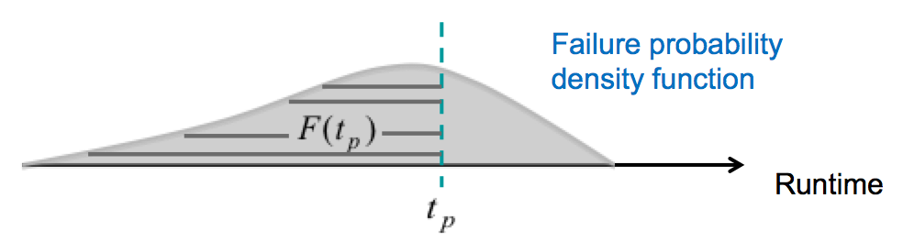
For a runtime-based component replacement policy
Maintenance policy optimization
Optimization Criterion

Slide 44
When to Inspect the component
Maintenance policy optimization
Based on “Conditional Failure Probability”
calculation after every inspection
“Risky” Component
Failure Curve After 2nd Inspection
reveals normalcy
Failure Curve After 1st Inspection
Failure Curve
(No Prior Inspection)
Max Non-Detection
Probability (5%)
Cycles to First
Inspection (2235)
Cycles to Second
Inspection (2741)
Cycles to Third
Inspection (3248)
At most 10% chance of a Shroud wear in between Inspections

Slide 45
Implementing the Individual Failure Risk Score
Maintenance policy optimization
For Real-time Monitoring
Inspection Schedule Generation
Individualized Failure Indicator
Individualized Failure Indicator
#1 Inspection | #2 Inspection | #3 Inspection
1900 cycles | 1500 cycles | 800 cycles
Once the green line (risk) crosses the threshold, an inspection should be done
Inspection
#1
Inspection
#2
Inspection
#3
Cycles
Cycles
Monitor individualized cumulative failure risks score for a given component
Whenever the calculated risk score goes over the threshold, we trigger an “inspection event”
Individualized inspection schedule queue assuming the similar future usage (as history), this risk score calculator can help schedule the “next inspection event.”
Notice that subsequent events are shrinking with time
This slides demonstrates how this model can be used creating inspection schedule

Slide 46
Model Learning to Model Execution
Smooth transition from the learned model to the execution model.
Preparing input for the execution model
Presenting output from the execution model
Model update scheduling
Periodic or Condition-triggered

